Slide 1
WEEK 3 ASSIGNMENT
PRESENTATION DESIGN
GROUP 1
Aditya Agarwal (adi.ag321@gmail.com) Akash sheth (shethakash095@gmail.com) Meghna Raman (megraman1703@gmail.com) Ambika Chundru (chundru.ambika@gmail.com)
Ritish Alugolu (ritishalugolu@gmail.com)
Tanya Nijhawan (tanyanijhawan74@gmail.com)

Slide 2
TEAM INTRODUCTION
Meghna Raman - Team Lead, represents team to sponsor, via email and on calls, to minimize communication errors.
Aditya Agarwal- Project Manager, provides guidance and draws out insight from other team members, ensures that the project execution remains on track.
Ambika Chundru – Technical Lead, responsible for managing technical aspects of software development and executing technical solutions.
Ritish Alugolu - Project Lead, responsible for holding the group accountable for meeting deadlines and ensures that the project deliverables are being met.
Akash sheth- Project Lead, responsible for holding the group accountable for meeting deadlines and ensures that the project deliverables are being met.
Tanya Nijhawan- Project Lead, responsible for holding the group accountable for meeting deadlines and ensures that the project deliverables are being met.

Slide 3
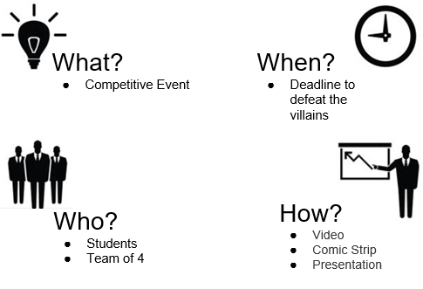
SUPERHERO U

Slide 4
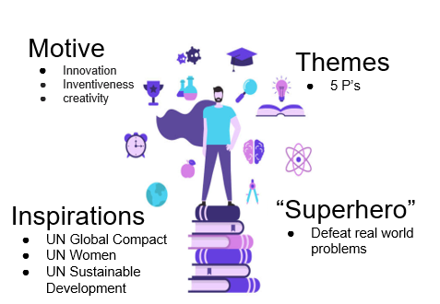
SUPERHERO U

Slide 5
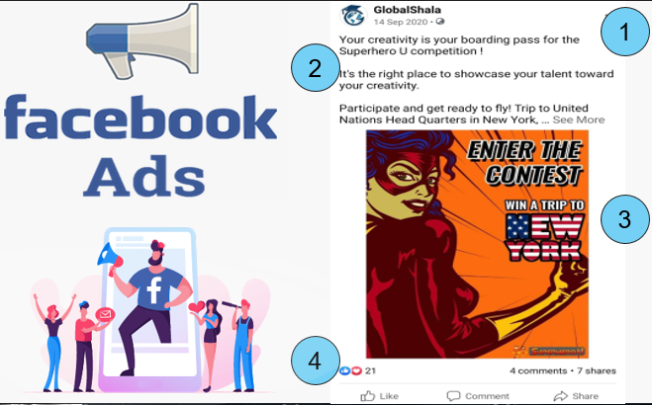
SUPERHERO U

Slide 6
OVERVIEW OF SUPERHERO U CAMPAIGNS
Number of Campaigns Analyzed: 11
Each Campaign was analyzed on the basis of the following parameters:
Campaign ID and Name
Target audience for the ad. Can be either “students “ or “educators”
Age
Geography the ad was served in
Reach-no. of people who saw the ad atleast once
Impressions- no. of times the ad was on a screen
Frequency- average number of times a person saw an ad

Slide 7

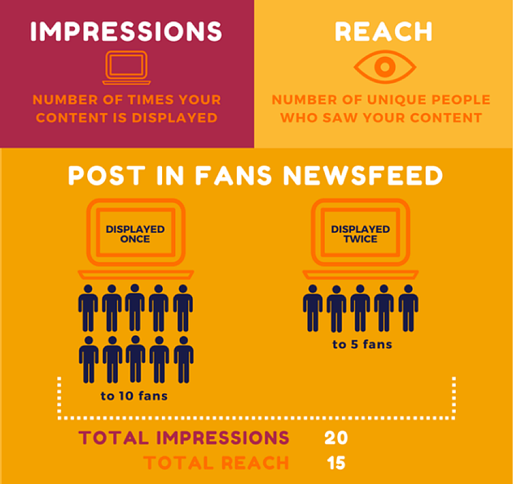
Clicks
Total number of unique clicks
Click Through Rate –number of people who saw the add and clicked the link
Amount spent in INR
Cost spent per Click (CPC)
Cost per Result(CPR)-total amount spent/total result or unique link clicks

Slide 8
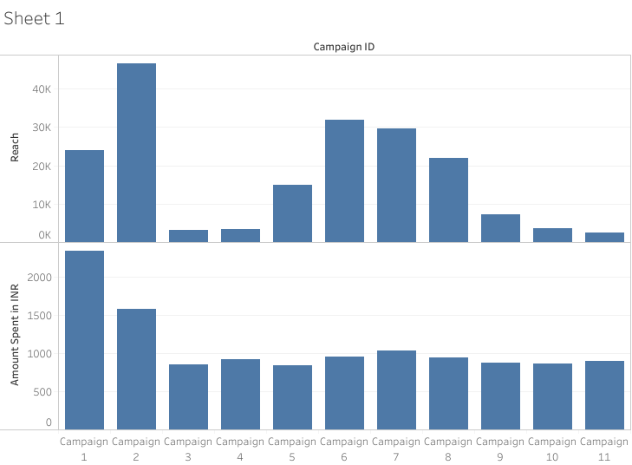
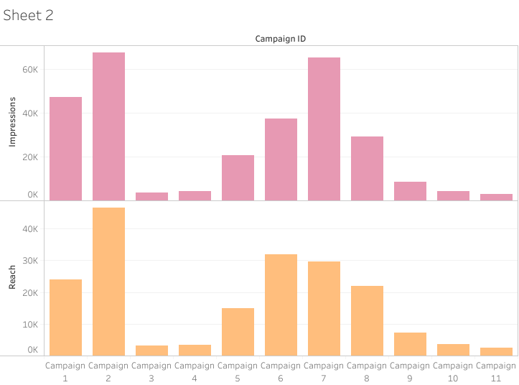

Slide 9
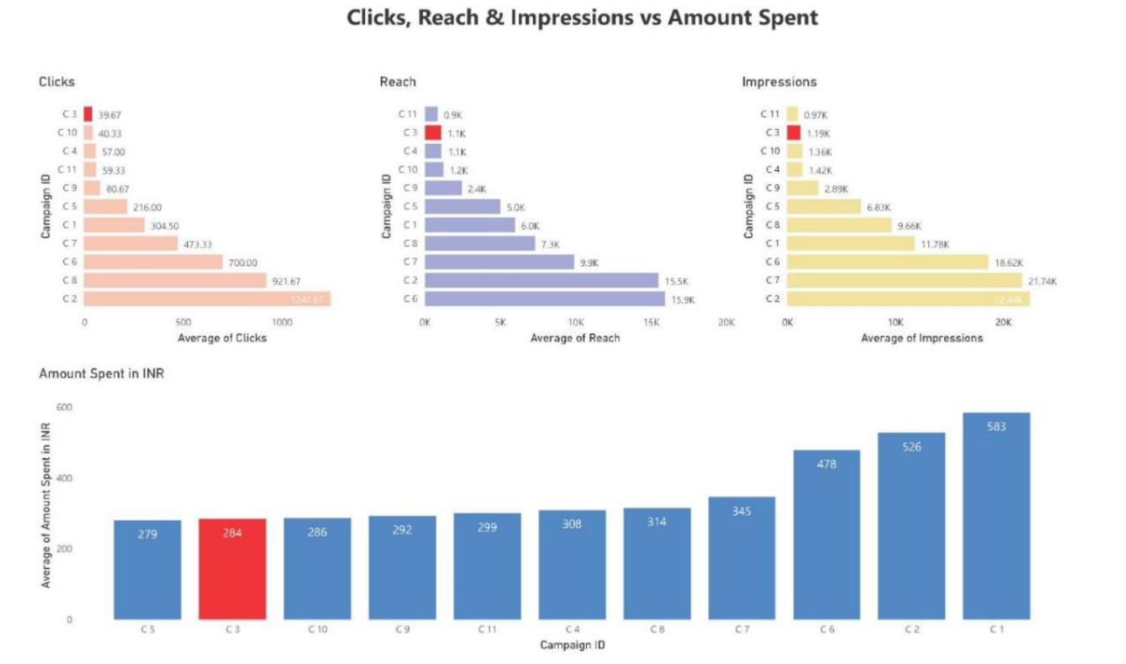

Slide 10
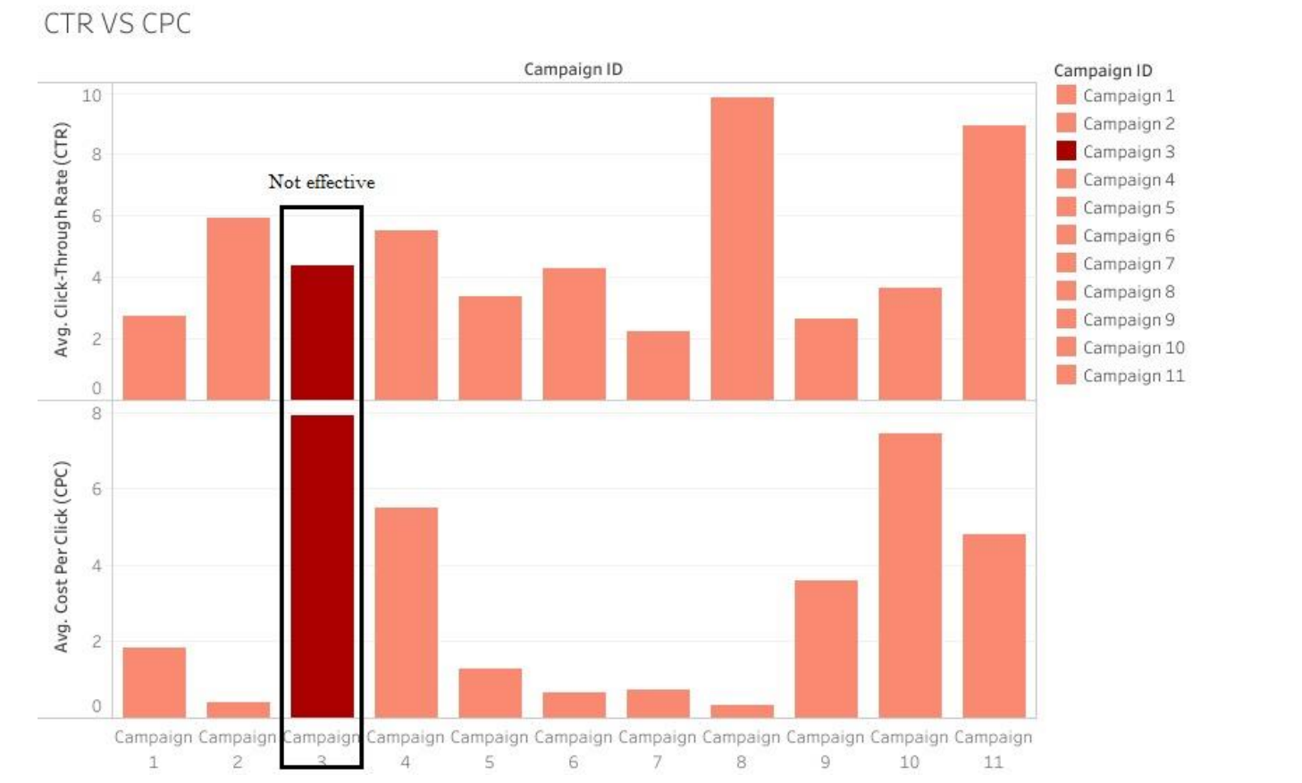

Slide 11
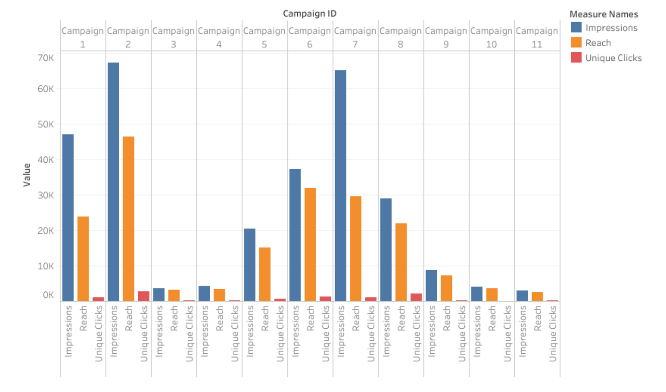

Slide 12
CONCLUSION
After analyzing the dataset given to us, we can comprehend that there are several factors which we can be considered to decide whether to continue a particular campaign or not.
After a brief discussion we have decided that the most important factors to be considered for discontinuing a campaign are Reach, Clicks, Impressions, Amount spent in INR, and Unique Clicks.
After visualizing and comparing the results, we came to a conclusion that Campaign 3 is having the lowest number of reaches and impressions, while also having a higher amount spent. Therefore, Campaign 3 can be considered for removal due to their low result and cost efficiency.

